Slide 1
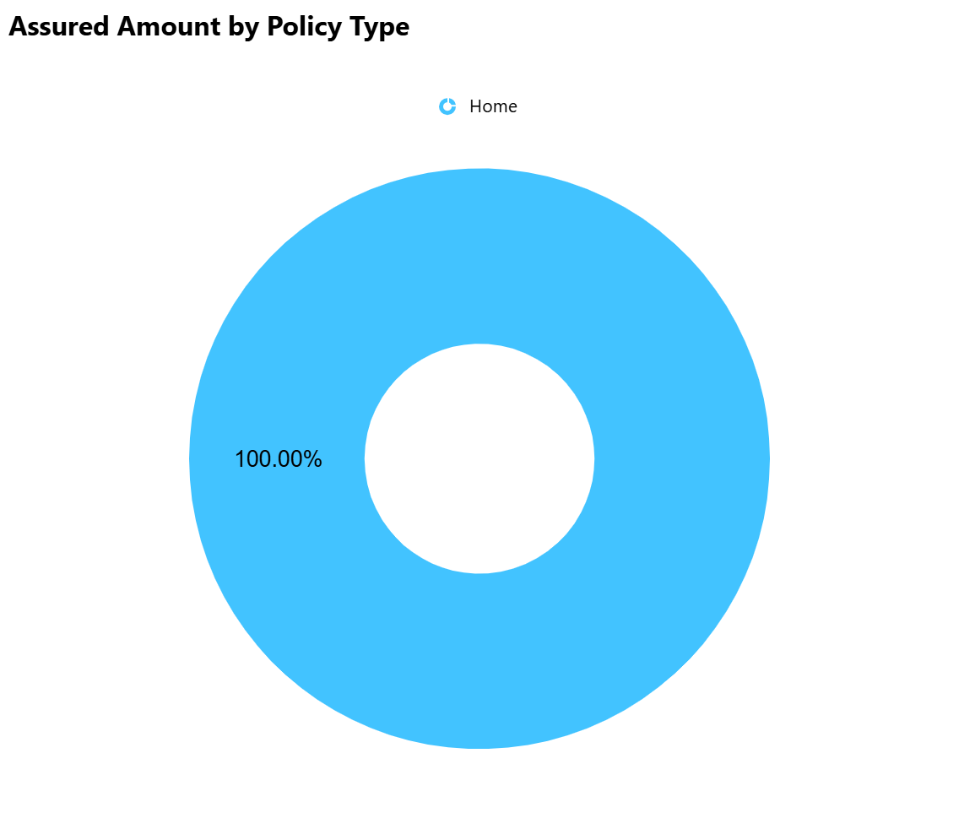
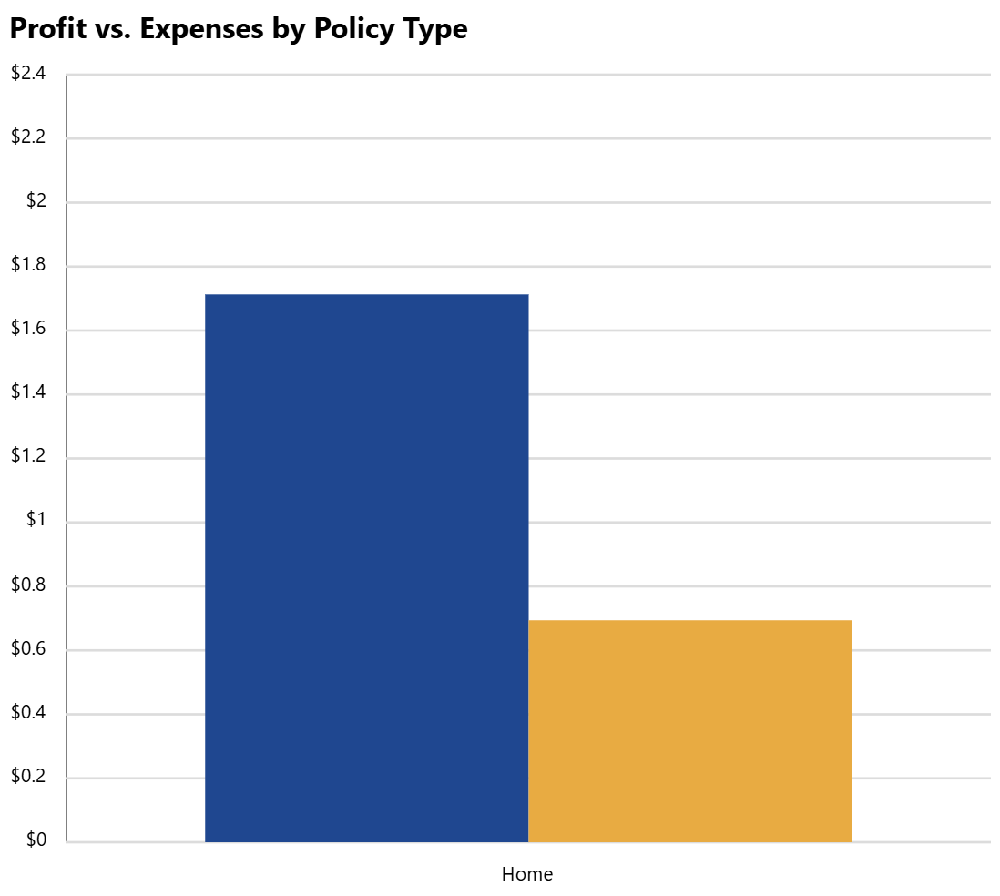
Insurance Performace Report﻿
Policies ﻿Sold
1
Assured Amount
$0.13M
Avg. Premium
$78.99K
Total Premium
$0.08M
﻿Annual Premium Equivalent Performance (APE) by Year and Policy Type
Avg. Claim Processing Time
 | 2021 | 2022 | 2023 | 2024
Disability | $0K | $1.5K | $60.38K | $41.3K
Health | $0K | $3.63K | $4.56K | $59.02K
Home | $0.42K | $0.89K | $55.38K | $122.44K
Life | $0K | $23.16K | $58.76K | $11.17K
Travel | $0K | $16.81K | $4.51K | $11.6K
8 Day(s)
Loss Severity
$1

Slide 2
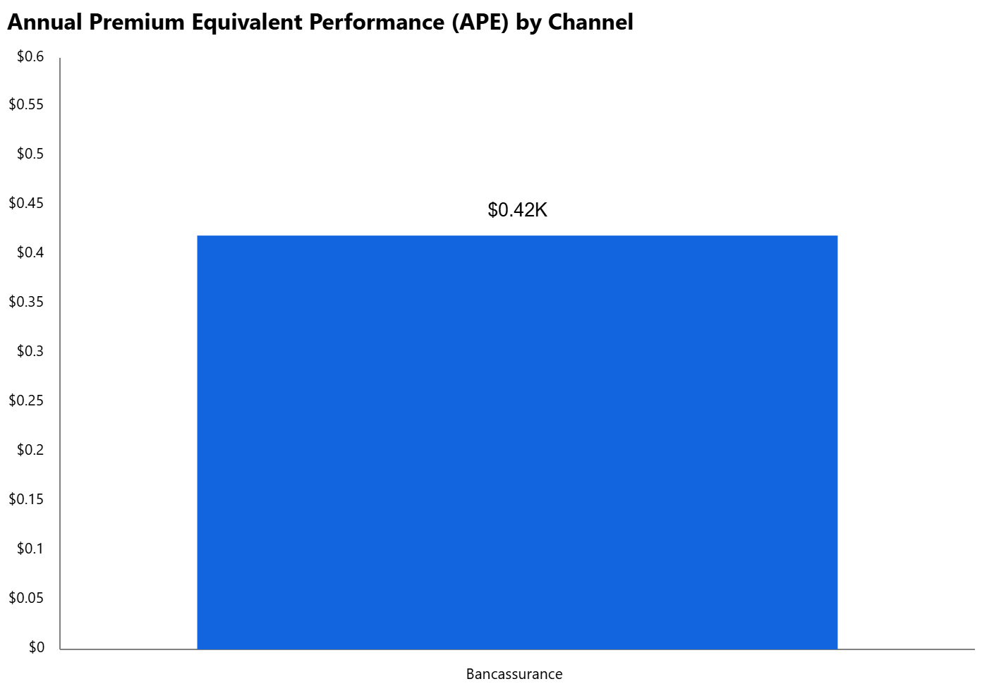
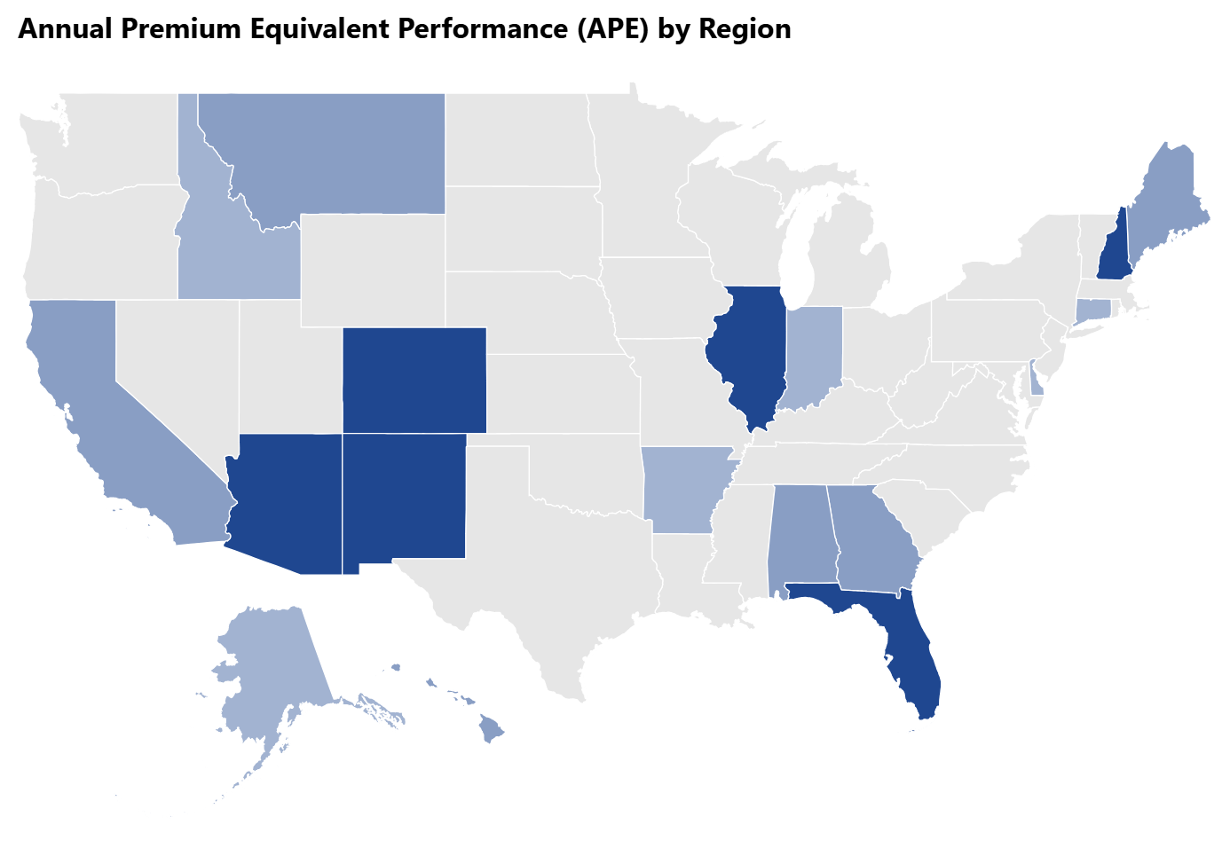
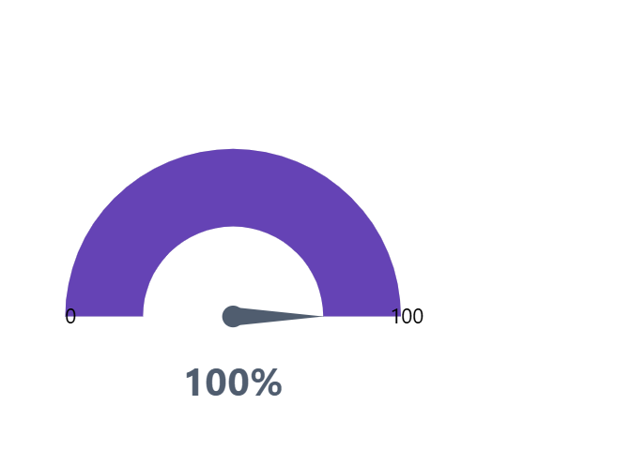
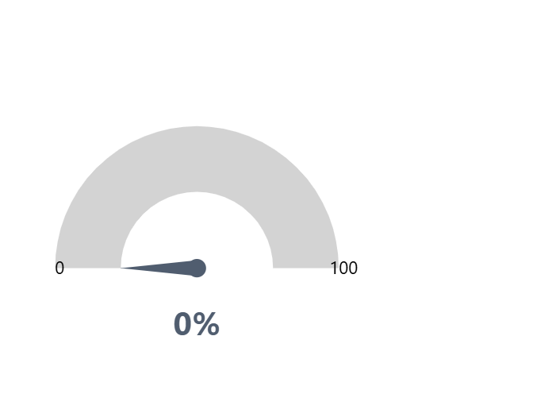
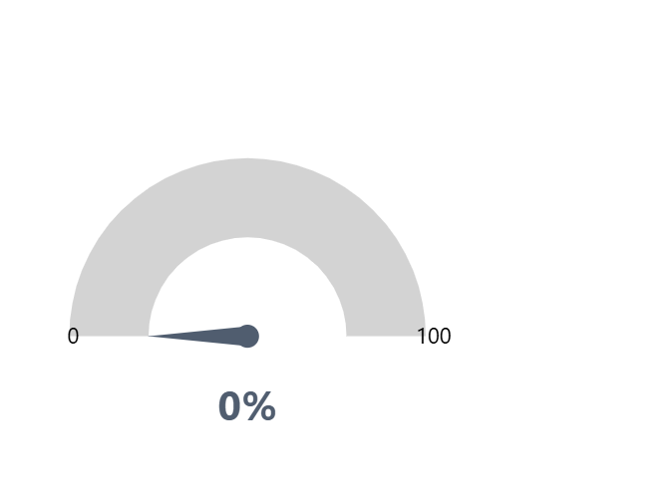
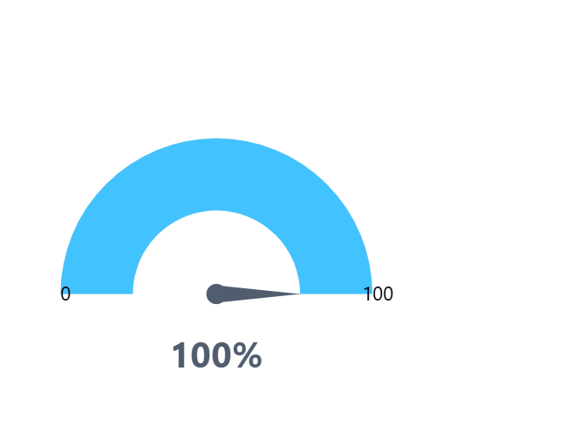
Insurance Performace Report﻿
﻿Customer Retention Rate﻿
Policy Renewal Rate﻿
Policy Lapse Rate﻿
﻿Net Promoter Score (NPS)﻿

Slide 3
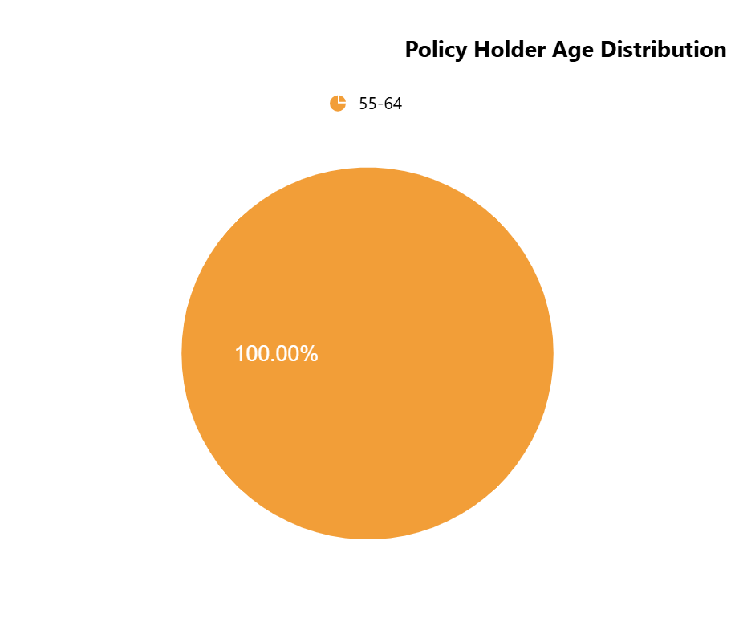
Insurance Performace Report﻿
﻿Insurance Performance Ratios
Policy Type | Claim Settlement Ratio | Claim Ratio | Expense Ratio | Loss Ratio | Underwriting Loss Ratio | Combined Ratio
Home | 100.00 % | 0.27% | 0.45% | 0.27% | 94.85% | 0.01%

